Slide 1

A gamified introduction to Python Programming Lecture 15 Introduction to Objects and OOP
Matthieu DE MARI – Singapore University of Technology and Design

Slide 2

Outline (Chapter 15)
What are objects and classes? How to they relate to dictionaries?
What are attributes and methods in a class?
What is the __init__ constructor method?
What is the __dict__ special attribute?
What are special methods in Python?
What is the “has-a” relationship in OOP?
(What is the “is-a” relationship in OOP?)
(What are the different attributes privacies?)
(What are setters, getters and properties?)

Slide 3
What is object-oriented programming?
Definition (Object-Oriented Programming):
Object-oriented programming (OOP) is a programming language paradigm organized around the creation of custom objects.
Sometimes, the concepts we need for our programs cannot be described using only the basic int/float/str/list/dict types.
We could assemble variables that relate to the same concept into dictionnaries (what we described as object-oriented thinking), we often prefer to create our own custom types/objects.
These types are created using the class keyword, and might come with their own list of attributes and methods.

Slide 4

Our toy example: an RPG main protagonist
Let us say we would like to code a video game and design our main character/protagonist.
Our main character can be represented as a custom class object.
It would have several attributes, e.g.
A name (string type, ‘Sir Meowsalot’)
A class (string type, ‘Warrior’)
Some lifepoints (int types, 100)
And many other attributes (intelligence, strength, speed, armor, etc.)

Slide 5
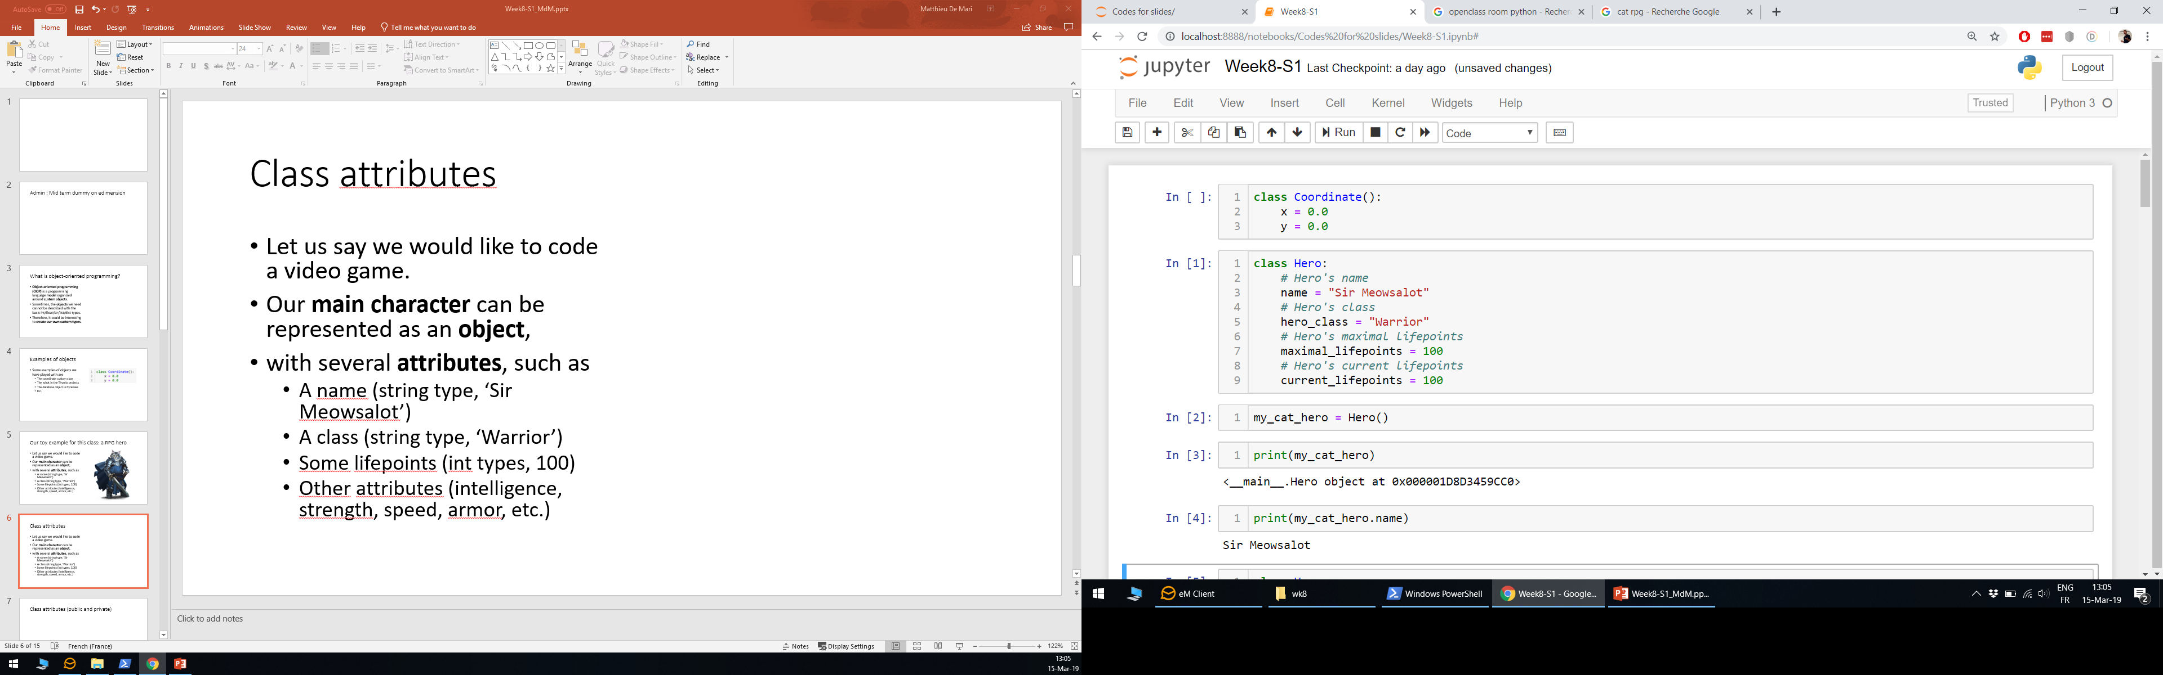
Class attributes
Let us say we would like to code a video game and design our main character/protagonist.
Our main character can be represented as a custom class object.
It would have several attributes, e.g.
A name (string type, ‘Sir Meowsalot’)
A class (string type, ‘Warrior’)
Some lifepoints (int types, 100)
And many other attributes (intelligence, strength, speed, armor, etc.)

Slide 6
Class attributes
To give you an analogy:
The def keyword was used to introduce new functions.
The class keyword is used to introduce a new type of variable to Python.
Here we defined the blueprint for a new class “Hero”.
Later, we created a variable my_cat_hero, which is a variable of type “Hero”.

Slide 7
Class attributes
Definition (object attributes):
In Python, object attributes are variables that are associated with an object and belong to a class.
These attributes store values and data that are relevant to the object.
They are defined within the class block, as variables and can later be accessed using the . notation on our object variable (like when we did a.shape in Numpy).

Slide 8
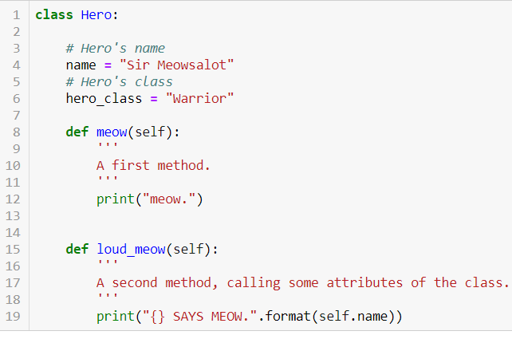
Class methods
On top of a class attributes, we can also define class methods.
Methods: functions which apply on our custom object.
Methods may use/modify some of the objects attributes.

Slide 9
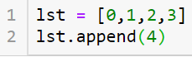
The self keyword
In all the methods we used a keyword, called self.
Self simply refers to the object on which the method applies.
In the case of lst.append(4), self designated the list lst on which append() was applied.

Slide 10
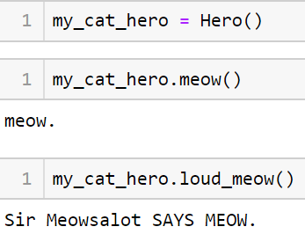
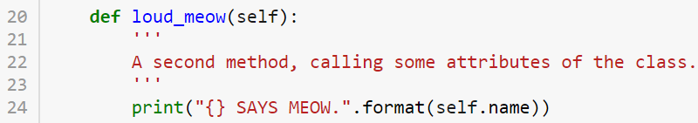
The self keyword
In all the methods we used a keyword, called self.
Self simply refers to the object on which the method applies.
In the case of my_cat_hero.meow(), self will refer to our newly typed variable my_cat_hero.

Slide 11
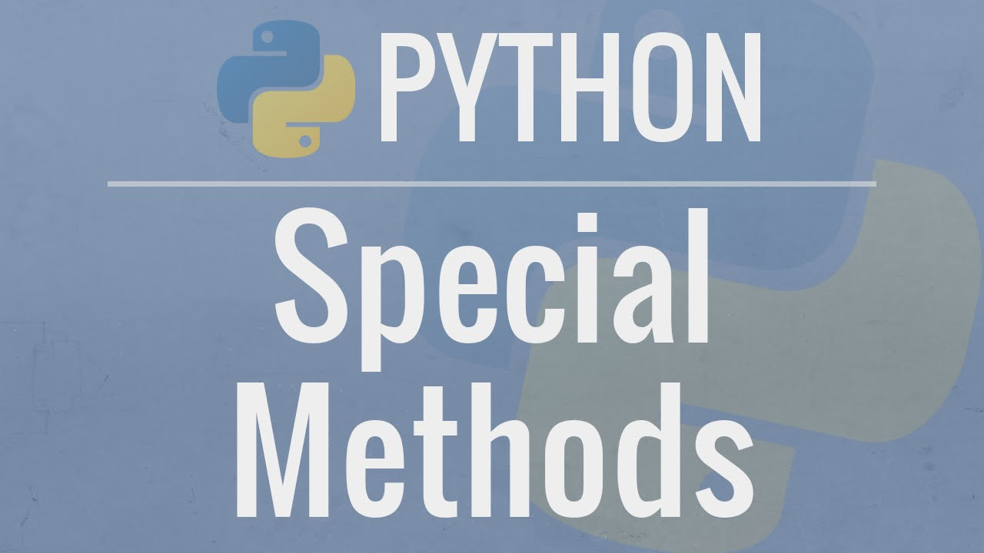
Class special methods
Definition (special methods):
A custom class may also have special methods.
These methods have fixed names and are written with double underscores (__) before and after their names.
These methods do something special when some basic operations (+, *, len(), etc.) are applied to our object.

Slide 12
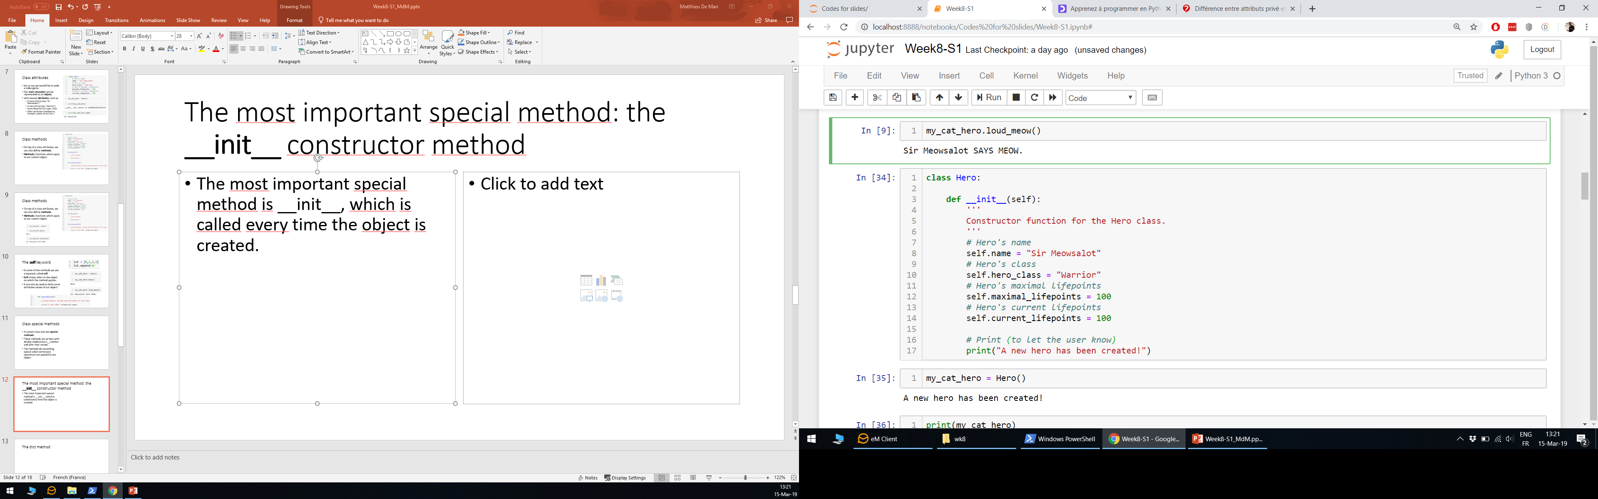
The most important special method: the __init__ constructor method
Definition (the __init__ method):
The most important special method is __init__, which is called behind the scenes every time an object is created.
This is called the constructor method of the class.
When we run the operation my_cat_hero = Hero(), Python runs whatever is in the __init__ method of the Hero class.

Slide 13
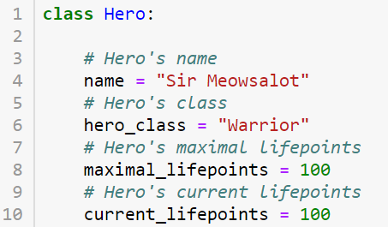
The __init__ constructor vs. « trash » initialization
It is often preferable to define and use the __init__ method!
It is considered good practice.
It also allows for more actions on initialization.

Slide 14
The __init__ constructor vs. « trash » initialization
It is often preferable to define and use the __init__ method!
It is considered good practice.
It also allows for more actions on initialization.

Slide 15
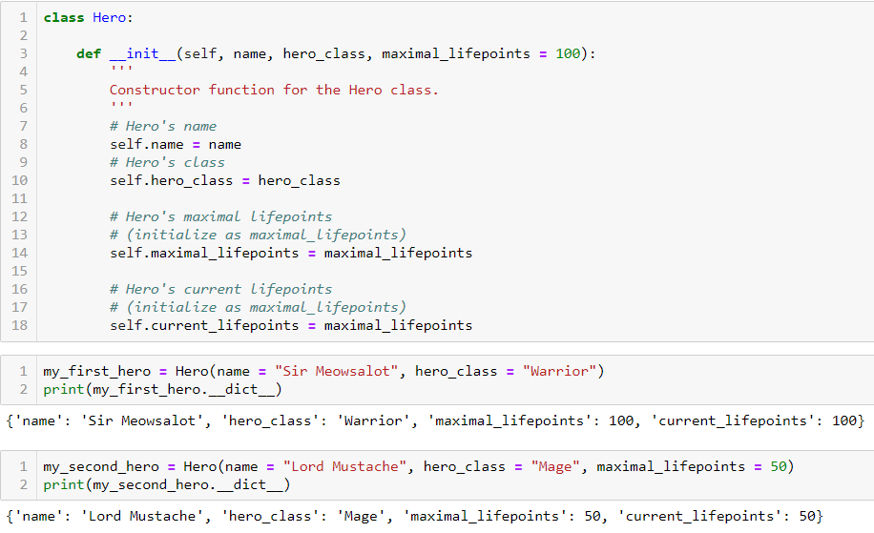
While we’re at it, let us talk about default values in methods and functions
We can also define inputs and default values in our methods and special methods.
Here __init__ expects a name and a hero_class, as mandatory inputs.

Slide 16
While we’re at it, let us talk about default values in methods and functions
We can also pass an optional input, the maximal_lifepoints value.
If no value is passed for maximal_lifepoints, we initialize it, by default, to 100.

Slide 17
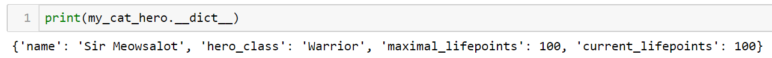
The __dict__ special attribute
Definition (__dict__):
Another useful concept is the special dictionnary attribute, __dict__.
By default, it produces a dictionnary
containing all the attributes of your object and their currently assigned values.
(Looks familiar? → OOT!)

Slide 18
Practice 1
Let us put these concept in practice with a first Activity.
You will have to design several custom classes of objects.
Some of them will require attributes and methods.
Some of them will require to write __init__ methods.
Remember to control the values of attributes in your objects using the __dict__ operation!

Slide 19
Class special methods
Definition (special methods):
A custom class may also have special methods.
These methods have fixed names and are written with double underscores (__) before and after their names.
These methods do something special when some basic operations (+, *, len(), etc.) are applied to our object.

Slide 20
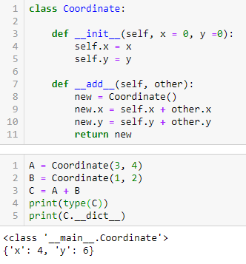
About special methods
Definition (__add__):
There are more special methods, besides the __init__ one. The __add__ special method defines the behavior you want for your objects when two objects of our custom class are summed together with +.
This allows us to control what the + behavior should be. This decided that + would be concatenation for strings/lists, math addition for int/float, etc.

Slide 21
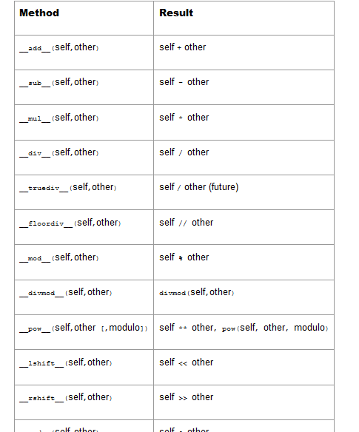
About special methods
Typically, we will have special methods for each operator (+, -, *, /, etc.), and built-in function (len, print, etc.).
While it would be impossible for me to describe and showcase all of them one by one, you can easily find them in the documentation, here: https://docs.python.org/3/reference/datamodel.html#special-method-names

Slide 22

The str special method
Definition (__str__):
The __str__ special method defines what happens when you attempt to convert your custom object into a string type object.
It is typically useful to decide what should be displayed on screen when you attempt to print() your object!

Slide 23
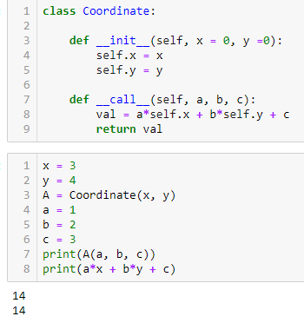
Call method
Definition (__call__):
The __call__ special method defines what happens when you attempt to call your custom object and attempt to use it as a function and pass it some arguments.
This also serves to show that functions are, technically, “just a special type of variable”.
Functions defined with def could be seen as variables with a __call__ method containing your instructions. (Technically a gross oversimplification, but ok for now).

Slide 24
Practice 2
Let us put these concept in practice with a new Activity.
You will reuse several custom classes of objects from Activity 1.
Some of them will require some additional special methods.
Remember to control the values of attributes in your objects using the __dict__ operation!

Slide 25
Our toy example: an RPG main protagonist
Let us get back to our Hero object.
Problem: our Hero’s attack capabilities probably depend on the weapon he has equipped.
And this weapon should probably be an object as well!
Maybe we should have variables of type Weapon, and have them interact with the Hero class?

Slide 26
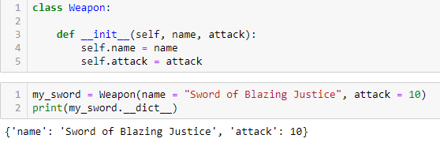
Introducing a Weapon class object!
Reusing the previous concepts, we could define a Weapon object
It will have its own attributes, such as
a name
some attack values,
and possibly more stuff.
(For now, let us keep it simple.)

Slide 27
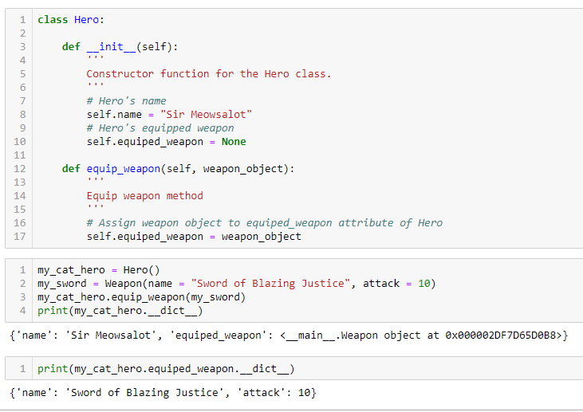
Equip a weapon! (a.k.a the « has-a » relationship)
We can then have our Hero equip a Weapon object, with our own equip_weapon() method.
It assigns a custom Weapon object (which we created earlier) to the attribute equiped_weapon of our Hero object.
Our Hero can then equip a Weapon object, with our equip_weapon() method!

Slide 28
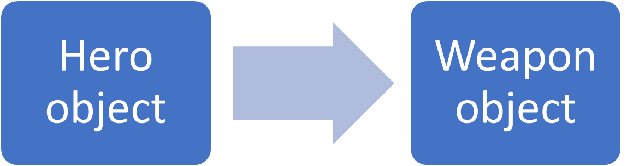
The « has-a » relationship
Definition (the “has-a” relationship in OOP):
In Object-Oriented Programming, this defines a “has-a” relationship between our Hero class and our Weapon class.
We then say that our Hero object “has-a” Weapon object.
Because one of our Hero object’s attributes is a Weapon object.
“has-a”

Slide 29
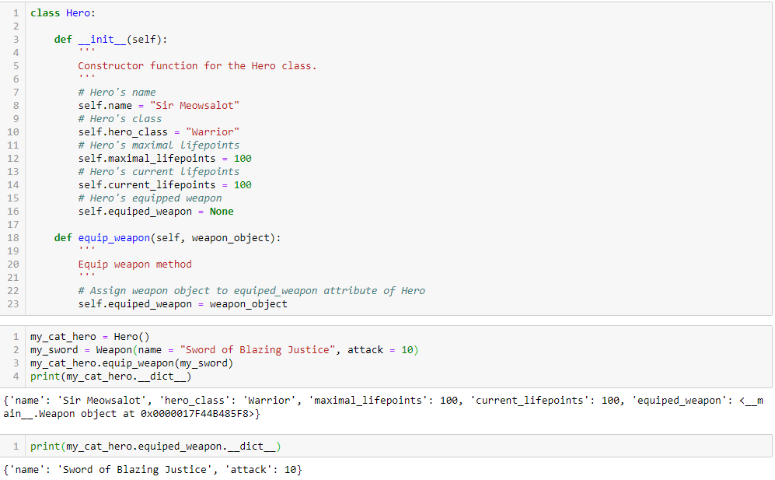

Slide 30
Practice 3
Let us put these concept in practice with a new Activity.
You will reuse several custom classes of objects from Activity 1&2.
You will have to implement new additional classes and establish some “has-a” relationships between the different classes.
Remember to control the values of attributes in your objects using the __dict__ operation!

Slide 31
Modifying our Weapon class object
Earlier, we defined a Weapon object, with attributes such as name and attack values.
Problem: how do we efficiently take into account multiple types of weapons possibilities? (sword, bow, axe, magic staff, etc.

Slide 32
Objects and sub-classes of objects
Typically, our Hero could equip a Weapon object...
But it could be a sword, a bow, a staff, etc.
These weapons will probably have attributes and methods in common.
But they might also have different attributes and methods, as our Hero will probably operate those weapons differently.
Weapon object
Sword object
Bow object
Staff object
Etc.

Slide 33
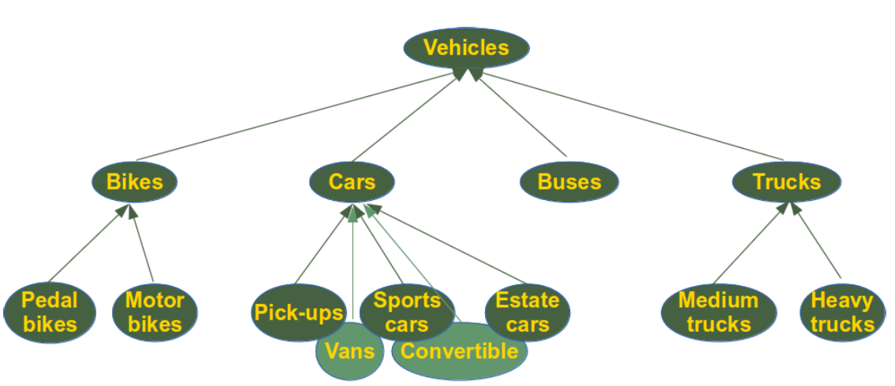
Objects and sub-classes of objects
In fact, it is common in life to have objects and sub-classes of objects.
Cars, buses and trucks probably have some attributes and methods in common, because they are vehicles objects.
But they probably have attributes and methods that are specific to them.

Slide 34
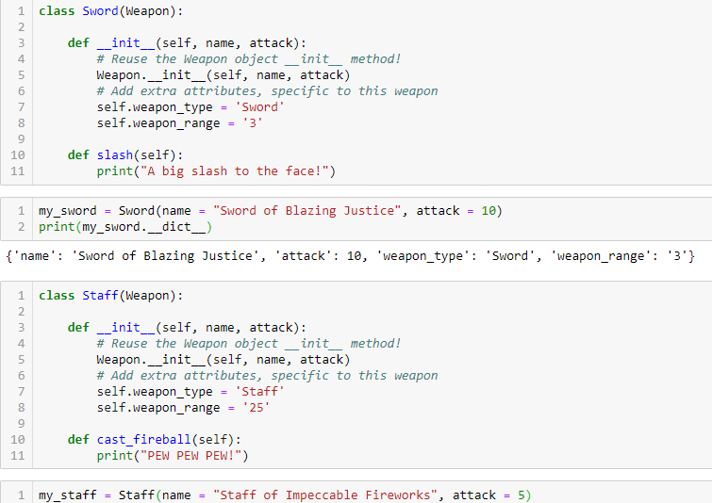
Introducting inheritance! (a.k.a. the « is-a » relationship)
Definition (Inheritance):
It is possible to create a class, which reuses methods and attributes from another class!
In OOP, this is called inheritance.
We simply mention the name of the previous class in the class definition!

Slide 35
Inheritance and « is-a » relationship
Inheritance is very useful
it allows for code reuse
and better architecture of the objects in your code!
Inheritance defines a « is-a » relationship between objects.
We say that Sword is the child class and Weapon is the mother class in that case. We might also refer to them as derived class and base class.
Sword object
Weapon object
« is-a »

Slide 36
Inheritance in practice
With inheritance, it is possible to create a class, which reuses methods and attributes from another class.
We simply mention the name of the previous class in the class definition.
And reuse the __init__ constructor from the previous class in the __init__ constructor of new class.

Slide 37
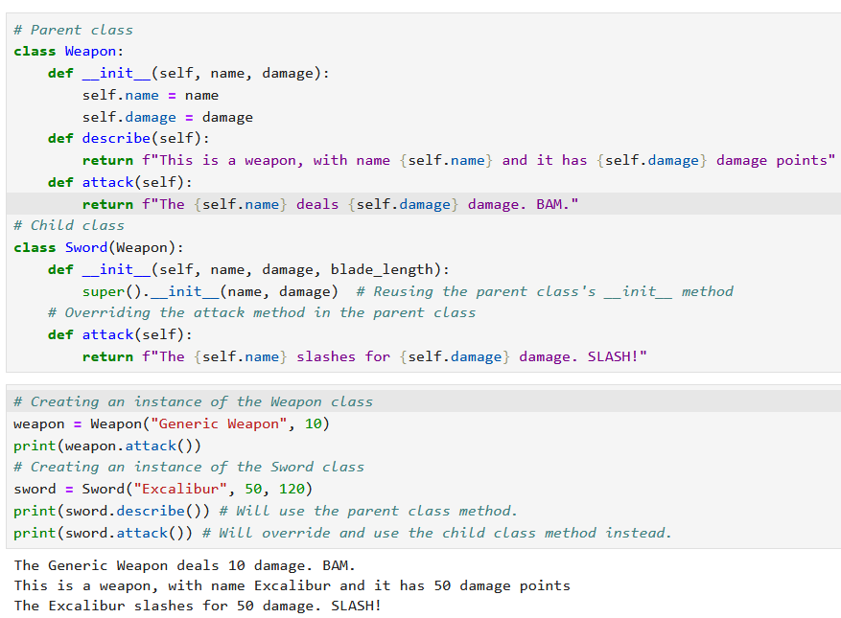
Inheritance in practice
On top of attributes, inheritance allows for methods reuse.
In addition, methods from the parent class can be reused freely by the child class.
If both the child class and the parent class have a method with the same name, the child class will override the method definition for objects of the child class.
(Will enlarge in the next slide.)

Slide 38
Inheritance in practice
On top of attributes, inheritance allows for methods reuse.
In addition, methods from the parent class can be reused freely by the child class.
If both the child class and the parent class have a method with the same name, the child class will override the method definition for objects of the child class.

Slide 39
Practice 4
Let us put these concept in practice with a new Activity.
You will reuse several custom classes of objects from Activity 1&2.
You will have to implement new additional classes and establish some “is-a” relationships between the different classes.
Remember to control the values of attributes in your objects using the __dict__ operation!

Slide 40
Some good practice in OOP
As mentionned earlier, using __init__ constructors for your class is considered good practice.
In addition, it could also be interesting to use setters and getters methods for your class attributes.
And also, to define if your class attributes should be public or private.

Slide 41
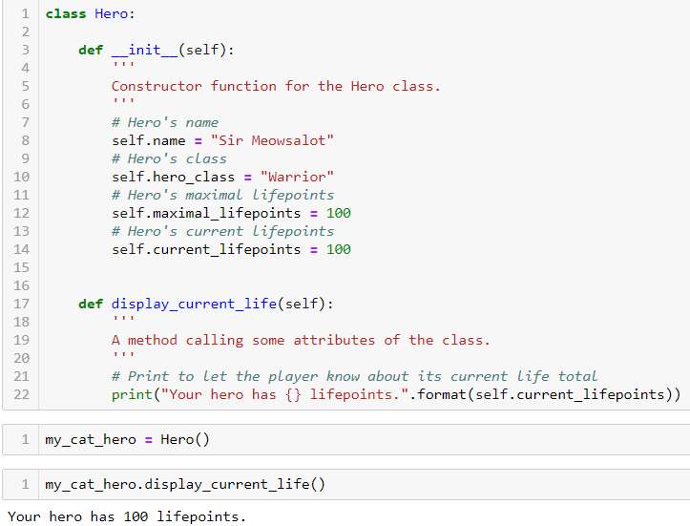
Display lifepoints method
Let us say we want to design a method that prints the current lifepoints of our Hero on screen.
A possible way to do it is this shown on the right.
And it works just fine!
However, this is considered bad practice.

Slide 42
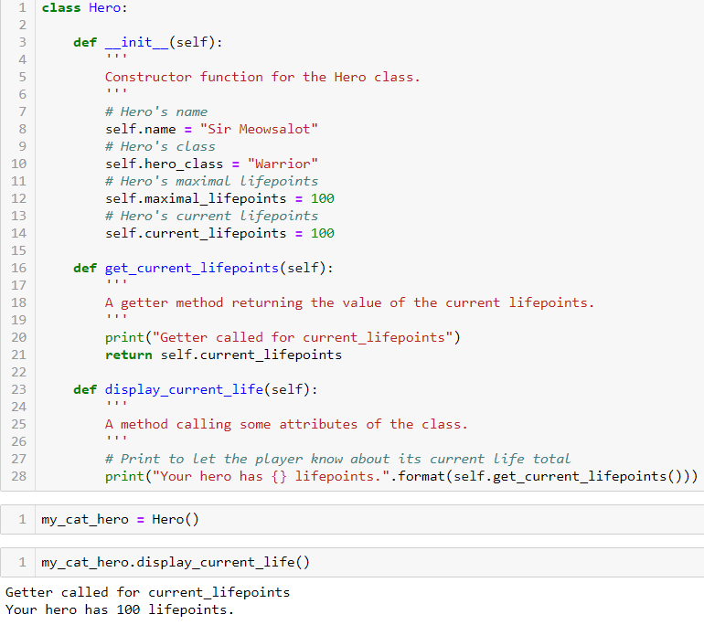
Setters and getters
Good practice: design methods for getting and setting attributes of a class
Getter method: fetches the current value stored in attribute.
Here, we demonstrate an example of a getter method and apply it in our method display_current_life().

Slide 43
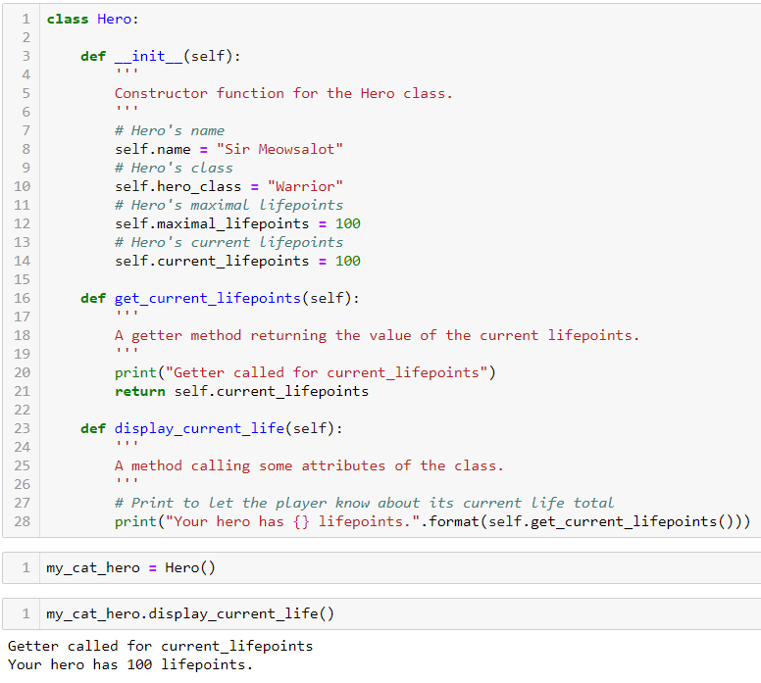
Why is it good practice to use setters and getters?
But, why would I write a getter method?!
It seems cumbersome for no reason!

Slide 44
Why is it good practice to use setters and getters?
Question: But, why would I write a getter method?!
It seems cumbersome for no reason!
Actually, it makes your code more modular and stable!

Slide 45
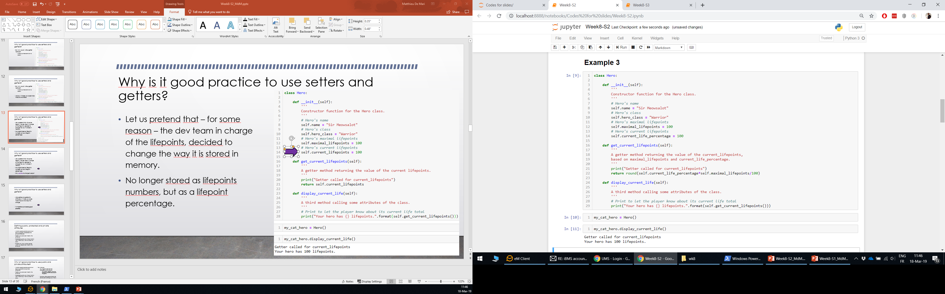
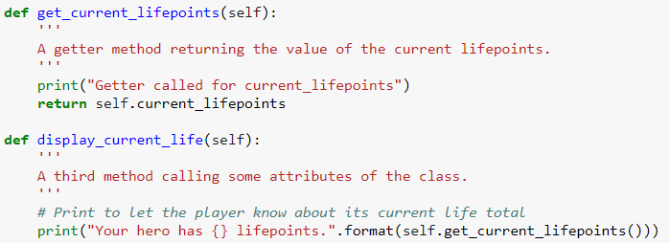
Why is it good practice to use setters and getters?
Let us pretend that – for some reason – the dev team in charge of the lifepoints, decided to change the way it is stored in memory.
No longer stored as lifepoints numbers, but as a lifepoint percentage.
Our methods no longer work!
But, only one line to change to make it work again!

Slide 46
Why is it good practice to use setters and getters?
Let us pretend that – for some reason – the dev team in charge of the lifepoints, decided to change the way it is stored in memory.
No longer stored as lifepoints numbers, but as a lifepoint percentage.
Our methods no longer work!
But, only one line to change to make it work again!

Slide 47
Why is it good practice to use setters and getters?
Lesson: using setters and getters for attributes will make your code more modular and robust to change.
It is therefore considered good practice.

Slide 48
Defining public, protected and private attributes
Type of attribute | Public | Protected | Private
Can be modified within the class methods. | Yes | Yes | Yes
Can be modified by function and methods outside of the class. | Yes | Yes | No
It is acceptable for this attribute to be modified by functions and methods outside the class. | Yes | No | Does not apply
Another good practice consists of defining public, protected and private attributes.
Public: everyone can modify the attribute.
Protected: public, but refrain from modifying it from outside the class.
Private: only the functions called within my object can modify the attribute.

Slide 49
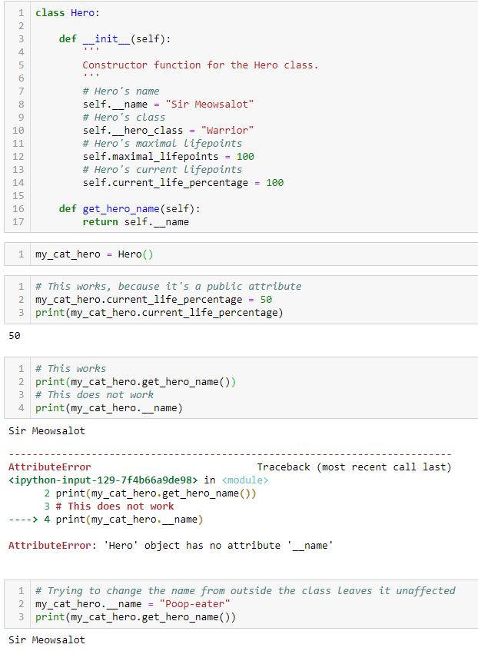
Private attributes
Private: only the functions called within my object can modify the attribute.
We can make an attribute private by adding a double underscore (__) in front of its name.
Calling it or modifying it has no effect.

Slide 50

Protected attributes
Protected: public, but should refrain from modifying it from outside the class.
We can make an attribute protected by adding a single underscore (_) in front of its name.
More of an indication to other devs working in your team!

Slide 51
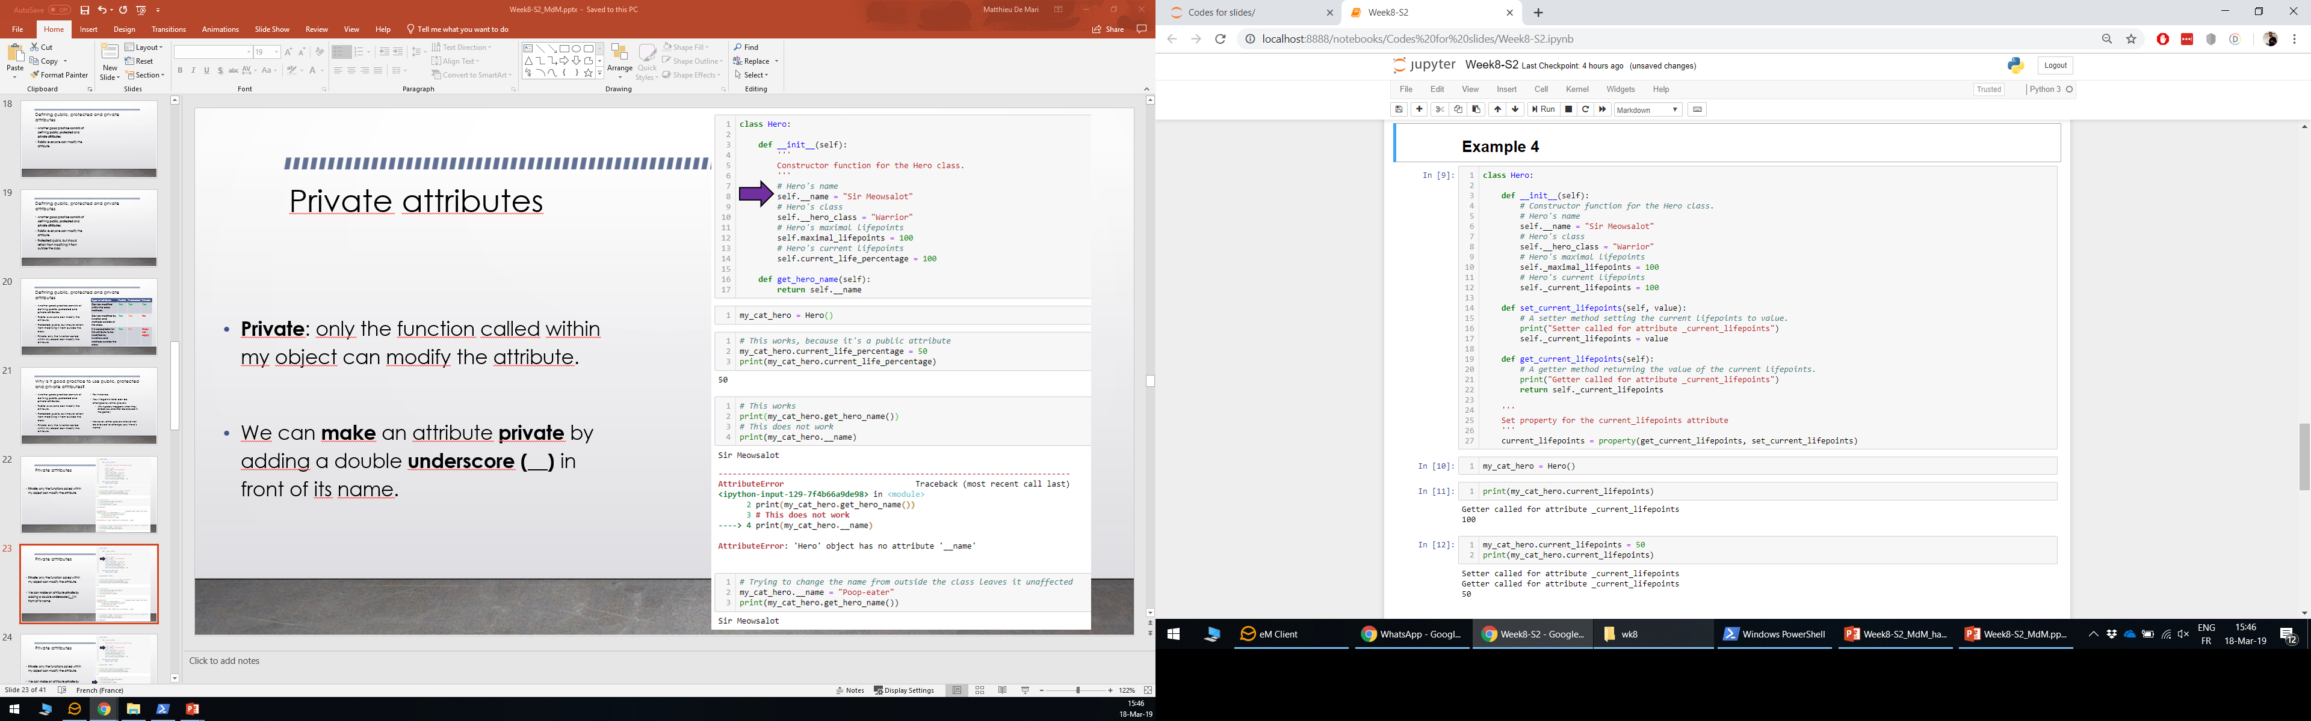
Merging everything, by setting attributes properties using the property keyword
Last but not least, it is also considered good practice to create properties.
i.e. default setter/getter methods for each attribute.
It is done with the property keyword.

Slide 52
Merging everything, by setting attributes properties using the property keyword
Thanks to the property keyword…
Whenever we execute my_cat_hero.current_lifepoints, we now automatically call the getter method, i.e.
my_cat_hero.get_current_lifepoints()

Slide 53
Merging everything, by setting attributes properties using the property keyword
And similarly, with the setter method, when we try to assign a value to our attribute.

Slide 54
Feel free to explore and play with OOP concepts!
They will bring your coding capabilities to great heights!
(At this point, you should also start to recognize how your favorite games/apps have probably been coded!)

Slide 55
Conclusion (Chapter 15)
What are objects and classes? How to they relate to dictionaries?
What are attributes and methods in a class?
What is the __init__ constructor method?
What is the __dict__ special attribute?
What are special methods in Python?
What is the “has-a” relationship in OOP?
(What is the “is-a” relationship in OOP?)
(What are the different attributes privacies?)
(What are setters, getters and properties?)

